Slide 1
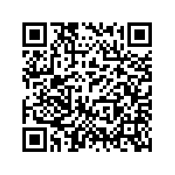
Understanding Christian Spirituality and Eating Disorders – Seeking Your Input
AT A GLANCE
Do you have lived experience of an eating disorder and currently or previously identify as Christian?
Have you had a close relationship with someone experiencing an eating disorder and believe that Christian spirituality was relevant to this journey?
Are you a healthcare professional working with people with eating disorders?
Or do you provide Christian pastoral care to people experiencing eating disorders?
We are seeking your help to understand how Christian spirituality and eating disorders may affect each other. We are interested in hearing your experiences, and designing a practical resource together to integrate Christian spirituality in eating disorder prevention and care, for people who would like this approach. For further information and to participate, please scan the QR code or email Dr Hayley Thomas (h.thomas@uq.edu.au).
This research is being conducted by a team from The University of Queensland, The University of Notre Dame, Flinders University and The Melbourne School of Theology, and is supported by a grant from The John Templeton Foundation.

